Slide 1
Bangalore Apartment Venue and Pricing Data Analysis
Submitted By: Ankit Parikh

Slide 2
Introduction
Bangalore with a huge employment and educational opportunities, is home to about 10 million people. Given this huge population, Bangalore has a burgeoning real estate market
The home buyers are looking at investing in the area that can help maximize return on investment
Retail investors are looking at investing (Restaurant, Coffee Shop, Gymnasium, etc.) in area with high population density
A solution/platform that can provide home buyers with useful information on their home investment and the retail inventors on the growing areas can prove very use
Such a solution can also provide useful insights to the government agency and civic body

Slide 3
Data Acquisition
Bangalore Apartment Location Data: This data is obtained from Kaggle which can be accessed here. This data set provides us with a list of all the apartments listed on Commonfloor website along with the geo-coordinates.
Bangalore Apartment Data: This data is obtained from Kaggle which can be accessed here. This data set provides us with a list of the apartments listed on Commonfloor website along with the price, area of the apartment, and unit type (1BHK, 2 BHK, etc.). BHK – stands for Bedroom Hall and Kitchen. 1 BHK – is a unit with one bedroom, 2BHK is a unit with two bedrooms, and so on.
Bangalore Neighborhood Data: This data is obtained from Kaggle and can be accessed here. This data set provides us details of Bangalore Neighborhood (Area), along with the geo-coordinates of the area.
Foursquare: We have also used Foursquare API to obtain details of the venue around the apartment

Slide 4
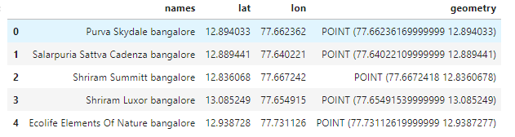
Methodology (Bangalore Apartment Location)
The main components of my master data consist of apartment name, area, and area’s geo-coordinates.
Apartment Name – obtained from “Bangalore Apartment Location” data set
Bangalore Apartment Location

Slide 5
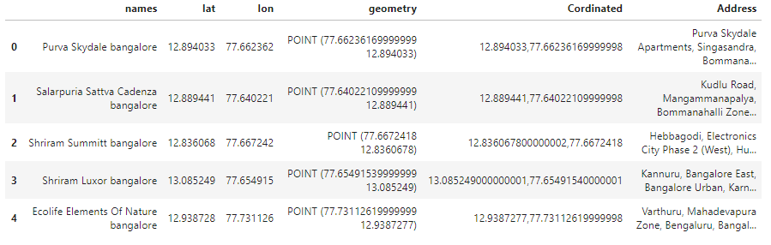
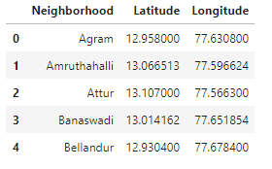
Methodology (Neighborhood and Neighborhood Location)
Area and its co-ordinates – these details are obtained by the following steps
Reverse Goe technique: we obtaining address for the apartment by using reverse geo technique – Here we passed the latitude and longitude details of the apartment to obtain the address for that apartment
We use “Bangalore Neighborhood” data to map the area latitude and longitude to data from step 1 – Here Address field in the table of step 1 and Neighborhood field in the table “Bangalore Neighborhood” is used as the joining keys
Bangalore Apartment Location with address (step 1)
Bangalore Neighborhood data

Slide 6
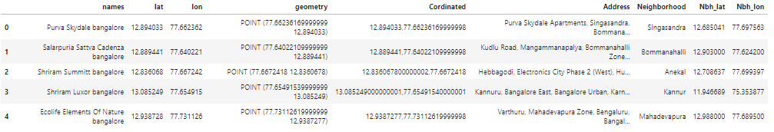
Methodology (Bangalore Apt location with Neighborhood location)
Bangalore Apartment Location, Area and its co-ordinates
Below is the result of join of the two tables as described on previous slide
Bangalore Apartment Location with address, Neighborhood and Neighborhood co-ordinates

Slide 7
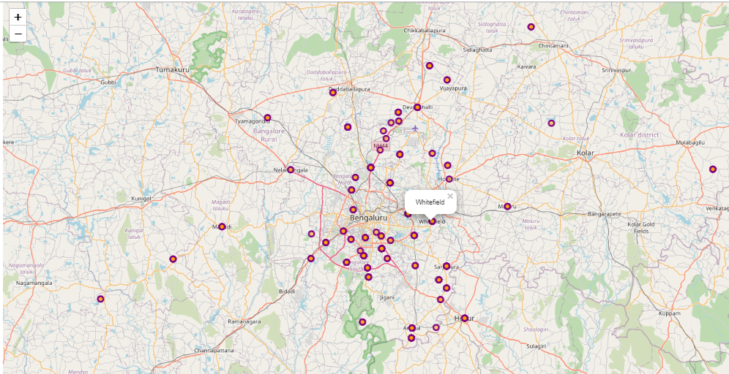
Methodology (Bangalore Neighborhood plot)
Bangalore Neighborhood plot: We used Folium library to plot the Neighborhood
Bangalore Neighborhood

Slide 8
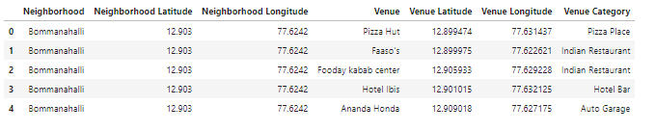
Methodology (Bangalore Neighborhood Venue Data)
Bangalore Neighborhood Venue:
I utilized Foursquare API to explore the venues nearby the areas of my data set. I designed a query to limit the number to 30 venues within a radius of 1000 meters of the area (neighborhood). Below is an excerpt from the data set of venues
(Note: to ensure optimal performance, we divided the data set into set of 100 line items for API calls)
Neighborhood Venues and Co-ordinates

Slide 9
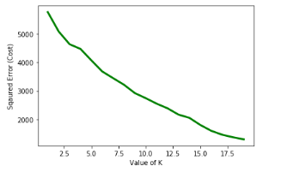
Methodology (Kmeans)
Kmeans Clustering:
As we want to cluster the area (neighborhood) of Bangalore, based on the venues in the given radius of 1 Km, I have used an approach of unsupervised clustering. Kmeans being one of the most popular and widely used clustering algorithm, I have used Kmeans as a clustering algorithm form clustering my data set.
To identify an optimal value of clusters, I ran the algorithm for different values of K to find the error associated with each value of K. below is the plot for different values of K and corresponding error.
For the graph we can see that the optimal has not yet converged
As a data science product owner, we have a job of playing a balancing act between finding optimal clusters and restricting the clusters to make the end user's (consumer of our service/application) life easy and to peak their interest.
Playing the balancing act, we decided to use value of 12 clusters
Kmeans optimization

Slide 10
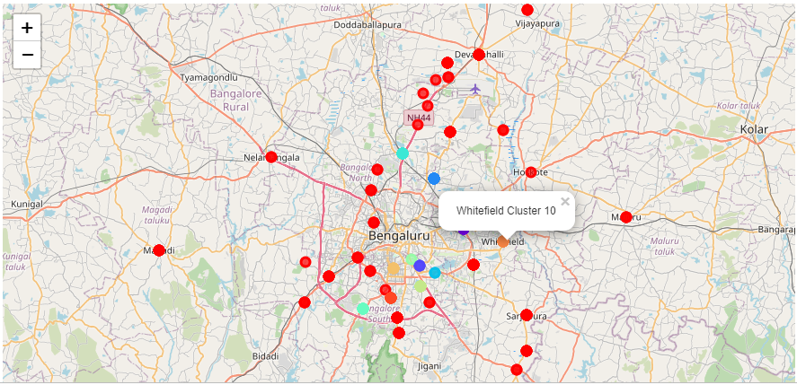
Results (Bangalore Neighborhood Cluster (12 clusters))
Neighborhood Cluster

Slide 11
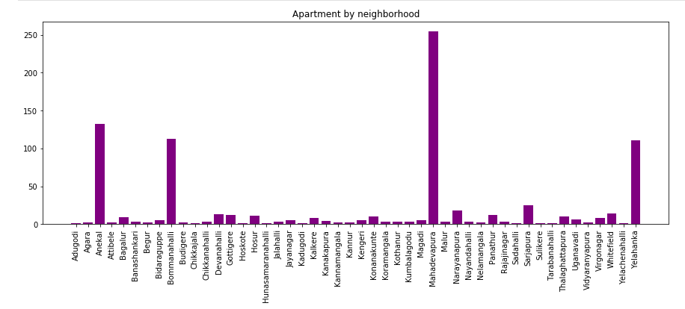
Results (Count of Apartments by Neighborhood)
Count of Apartment by Neighborhood

Slide 12
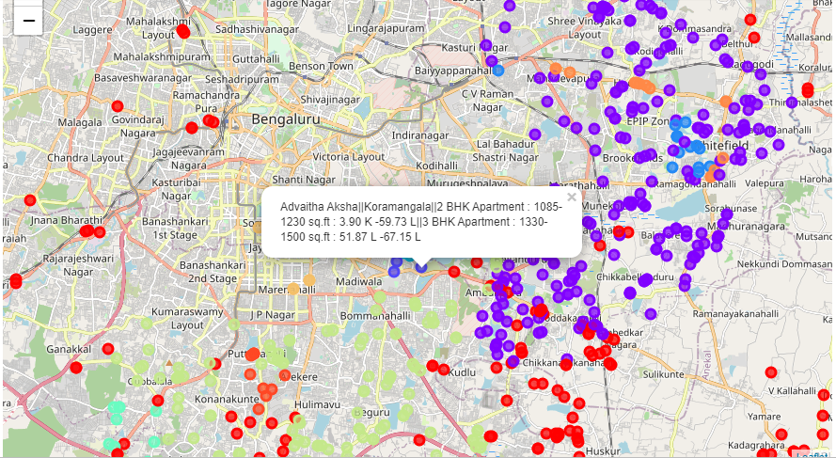
Results (Bangalore Apartment Details by cluster)
Bangalore Apartment Details by Cluster

Slide 13
Conclusion
As more people migrate to Bangalore, in search of employment and educational opportunity, an application or platform like this can prove useful for them by providing consolidated information on a click, that can aid them in informed decision making
Such a platform can also be used by retail investors looking at business opportunities like opening a restaurant, gymnasium, and others, as this platform can provide information on high population density areas and the type of services that are in shorter supply in those areas
This platform can also be used by the government agencies and civic bodies to better manage the development, infrastructure, and service needs of an area
Note:
There is huge scope for improvement on the solution where more interactive features and further refinement on the solution can by achieved a version 2 of the solution.

Slide 14
Conclusion
As more people migrate to Banglaore, in search of employment and educational opportunity, an application or platform like this can prove useful for them by providing consolidated information on a click, that can aid them in informed decision making.
Such a platform can also be used by retail investors looking at business opportunities like opening a restaurant, gymnasium, and others, as this platform can provide information on high population density areas and the type of services that are in shorter supply in those areas
This platform can also be used by the government agencies and civic bodies to better manage the development, infrastructure, and service needs of an area.

